Slide 1

Data Wrangling

Slide 2
Objectives
Pre-processing Data in Python
Describe how to handle missing values
Describe data formatting techniques
Describe data normalization
Demonstrate the use of binning
Demonstrate the use of categotical variables
Data Wrangling

Slide 3
Pre-processing Data in Python
Data preprocessing is a necessary step in data analysis.
It is the process of converting or mapping data from one raw form into another format to make it ready for further analysis.
Data preprocessing is often called data cleaning or data wrangling:
  Identify and handle missing values
  Data formatting
  Data Normalization( centering/ scaling)
  Data binning
  Turning Categorical values to numeric variables
Data Wrangling

Slide 4
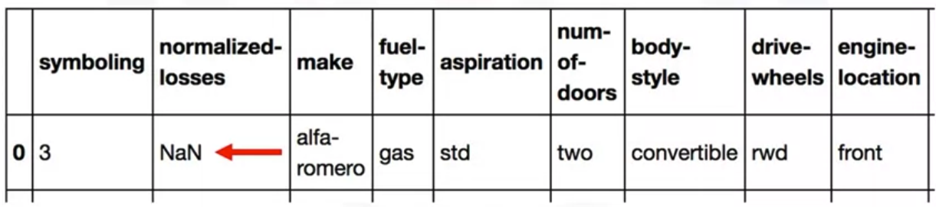
Dealing with Missing Values
A missing value condition occurs whenever a data entry is left empty.
When no data value is stored for a variable in an observation
Missing value in data set appears as question mark and a zero or just a blank cell.
Data Wrangling

Slide 5
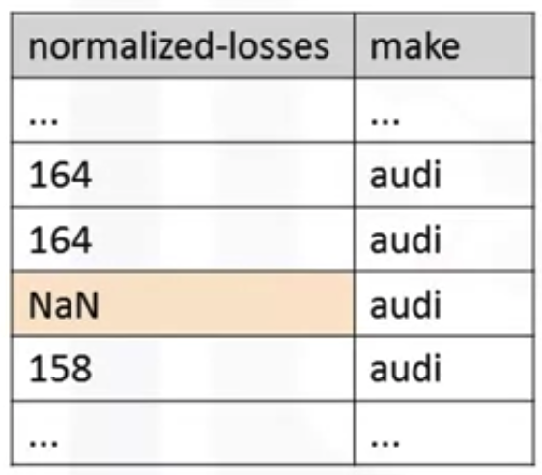
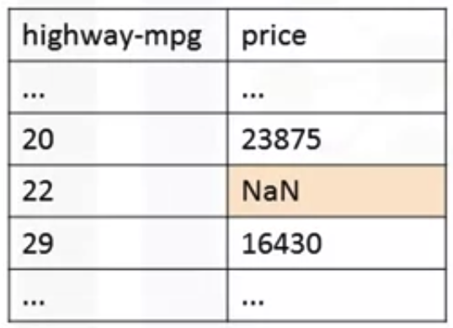
Dealing with Missing Values
How to deal with missing data?
--> Student give the opinions
Data Wrangling

Slide 6
Dealing with Missing Values
How to deal with missing data?
  Go back and find what the actual value should be
  Just to remove the data where that missing value is found
    Drop the whole variable
    Drop the single data entry with the missing value
    If you don't have a lot of observations with missing data, usually dropping the particular entry is the best.
Data Wrangling

Slide 7
Dealing with Missing Values
How to deal with missing data?
  Replace the missing values
    Replace it with an average
    Replace it by frequency
    Replace it based on other functions
  Leave it as missing data
    It may be useful to keep that observation even if some features are missing
Data Wrangling

Slide 8
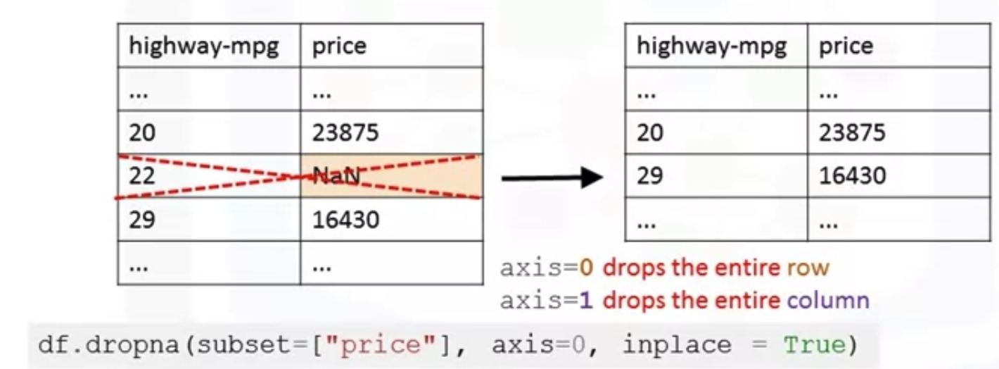
Dealing with Missing Values
Using dataframes.dropna() to drop missing data
Inplace= true: writes the result back into the data frame
Data Wrangling

Slide 9
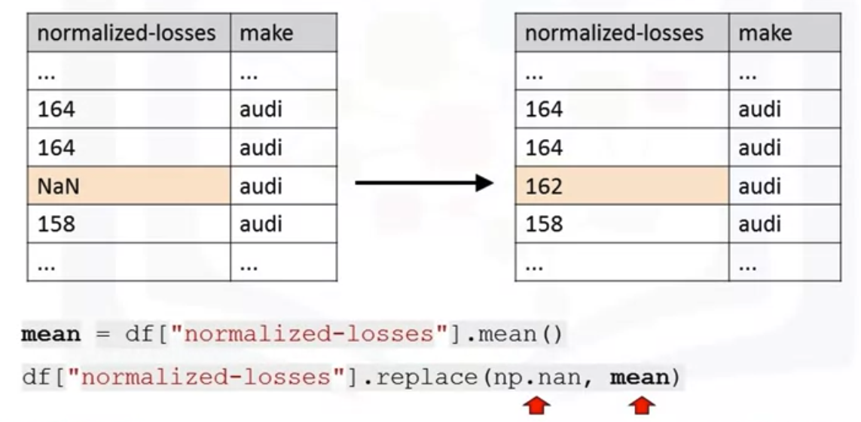
Dealing with Missing Values
Using dataframe.replace(missingValue, newValue): replace missing data by other value
Data Wrangling

Slide 10
Dealing with Missing Values
How to deal with missing data?
  Go back and find what the actual value should be
  Leave it as missing data
You can always check for a higher quality data set or source
You may want to leave the missing data as missing data.
Data Wrangling

Slide 11
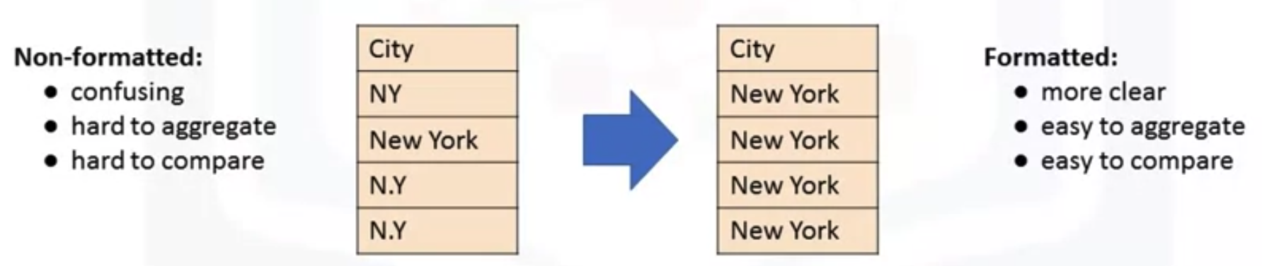
Data Formatting in Python
Data are usually collected from different places and stored in different formats
What is data formatting?→ bring data into a common standard of expression allows users to make meaningful comparison.
Data Wrangling

Slide 12
Data Formatting in Python
Data types in Python and Pandas
  Objects: “B”, “HoaDNT”
  Int64: 0,2,4
  Float64: 1.345, 78.9
To identify data types: dataframe.dtypes().
To convert data types: dataframe.astype().
Example: convert data type to integer in column “price”
Data Wrangling

Slide 13
Summary
Pre-processing Data in Python
Describe how to handle missing values
Describe data formatting techniques
Data Wrangling

Slide 14
Q & A
Data Wrangling

